Slide 1
Color Quantization with Parallelized K-means
Team 23
107062228 陳劭愷
107060002 曹立元

Slide 2
Outline
Introduction
Problem Formulation
Experimental Results
Conclusion

Slide 3
Outline
Introduction
Problem Formulation
Experimental Results
Conclusion

Slide 4
Introduction
K-means Algorithm
Color Quantization

Slide 5
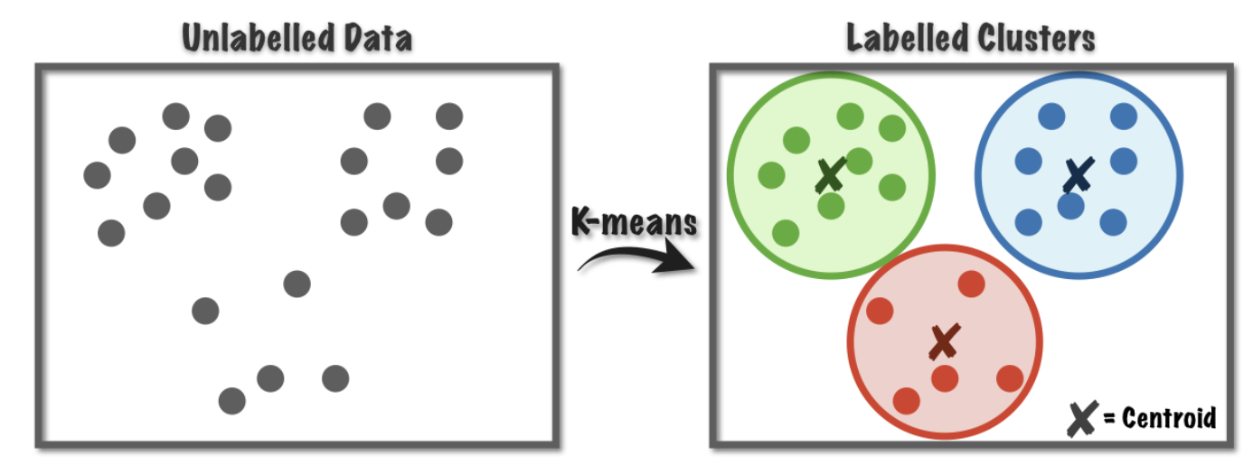
K-means
Clustering Algorithm
Widely used in Machine Learning
Market / image segmentation、recommandation engine

Slide 6
K-means
Algorithm & Analysis
Decide the number of clusters (k clusters)
Randomly assign k centroids in feature space
Each data point is assigned to the cluster of its nearest centroid based on the Euclidean distance
For each cluster, update the centroid by taking the mean of data points assigned to this cluster
Repeat step 3 and 4 until it converges

Slide 7
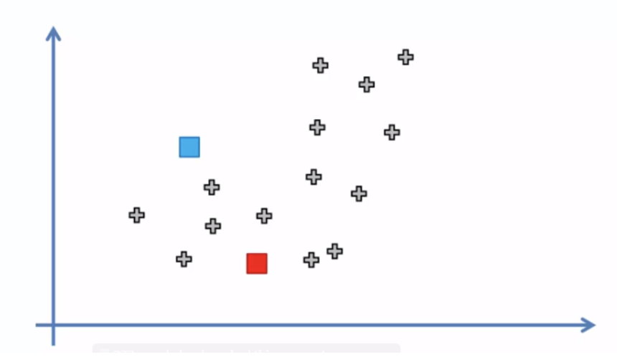
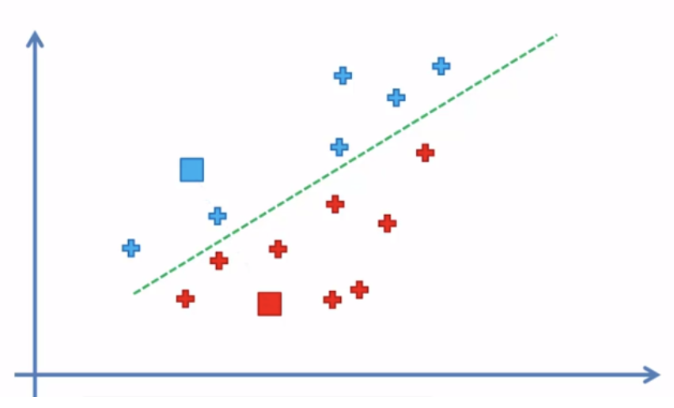
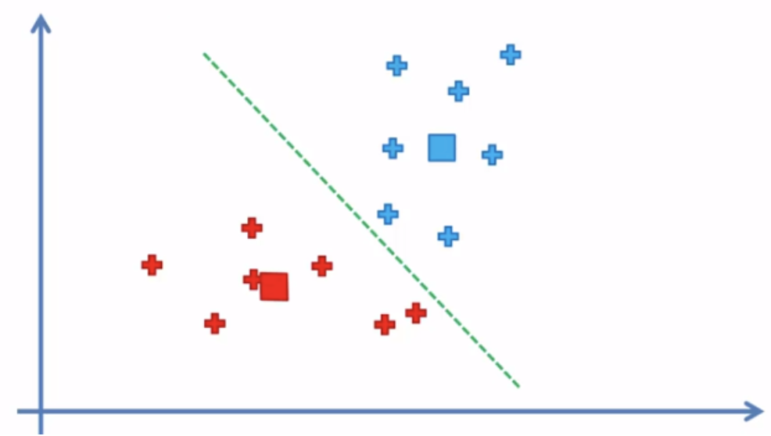
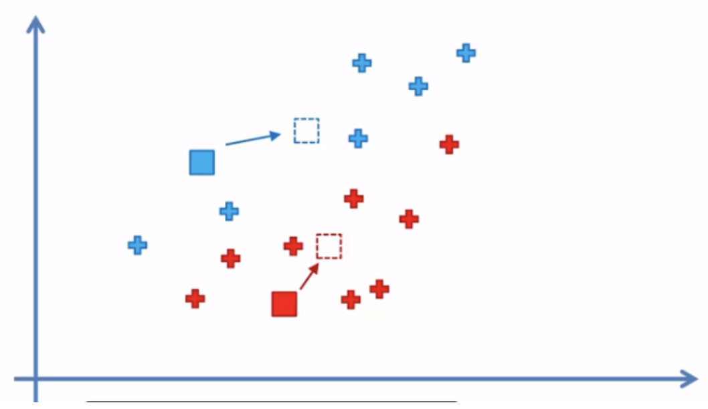
K-means Visualization

Slide 8

Color Quantization
Famous Computer Vision algorithm
Image Compression with little information loss
After color quantization (k=2)
Original Image

Slide 9
Outline
Introduction
Problem Formulation
Experimental Results
Conclusion

Slide 10
K-means
Abundant data makes n large
=> parallelize n !!
Algorithm & Analysis
Decide the number of clusters (k clusters)
Randomly assign k centroids in feature space
Each data point is assigned to the cluster of its nearest centroid based on the Euclidean distance
For each cluster, update the centroid by taking the mean of data points assigned to this cluster
Repeat step 3 and 4 until it converges
O(nkr)

Slide 11
Outline
Introduction
Problem Formulation
Experimental Results
Conclusion

Slide 12
Experiment Results
Statistical Results
Performance of sequential / OpenMP / CUDA
Speedup of multithreading
Issue of multithreading
CUDA Optimization
Profiling Results
Image compression of Color Quantization
Qualitative Results

Slide 13
Experiment Results
Statistical Results
Performance of sequential / OpenMP / CUDA
Speedup of multithreading
Issue of multithreading
CUDA Optimization
Profiling Results
Image compression of Color Quantization
Qualitative Results

Slide 14
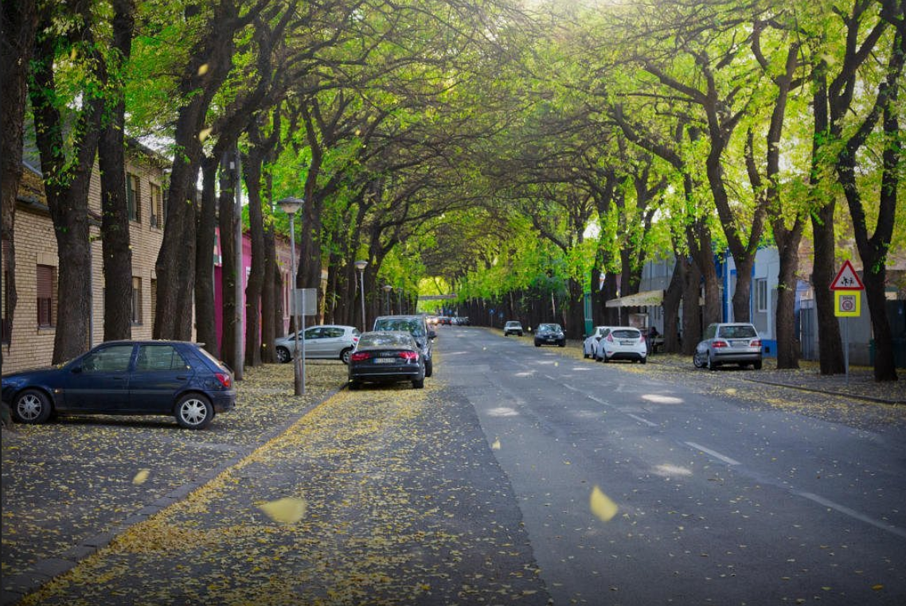
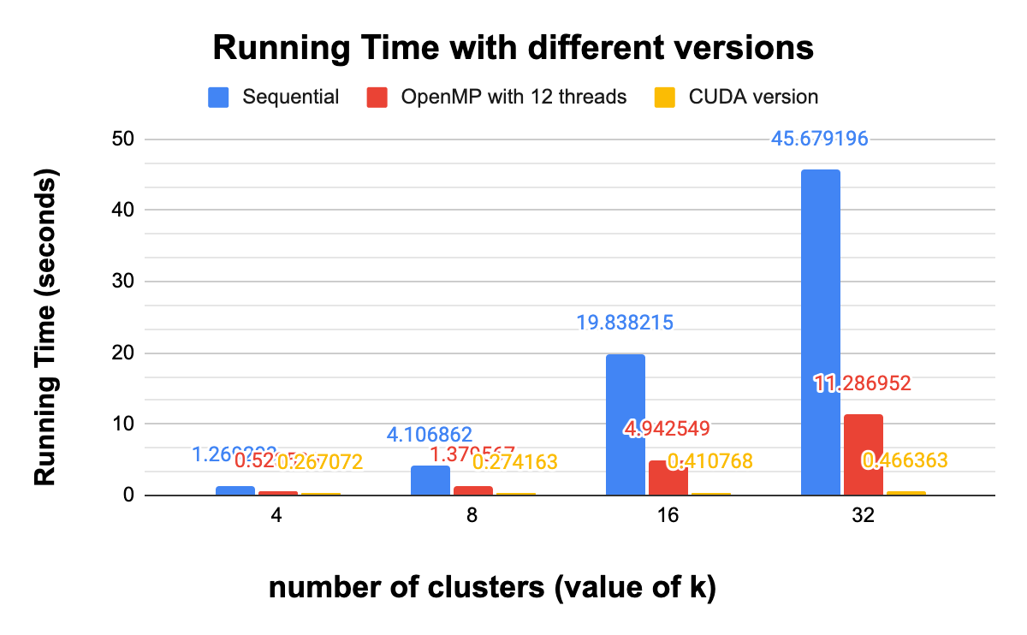
Statistical Result
First test image (resolution = 692 x 1025, size = 1.38MB)

Slide 15
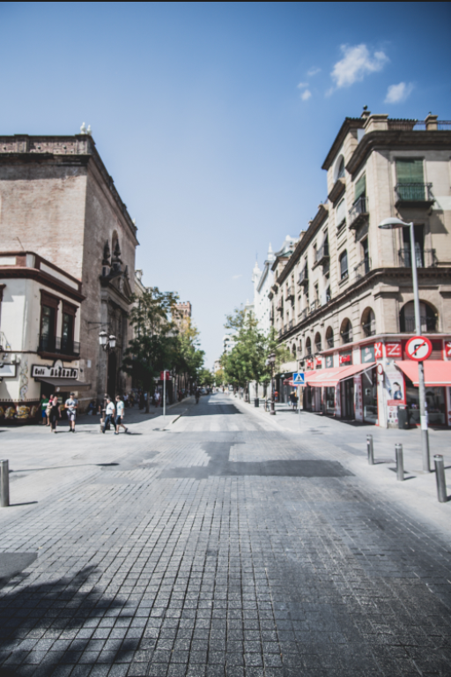
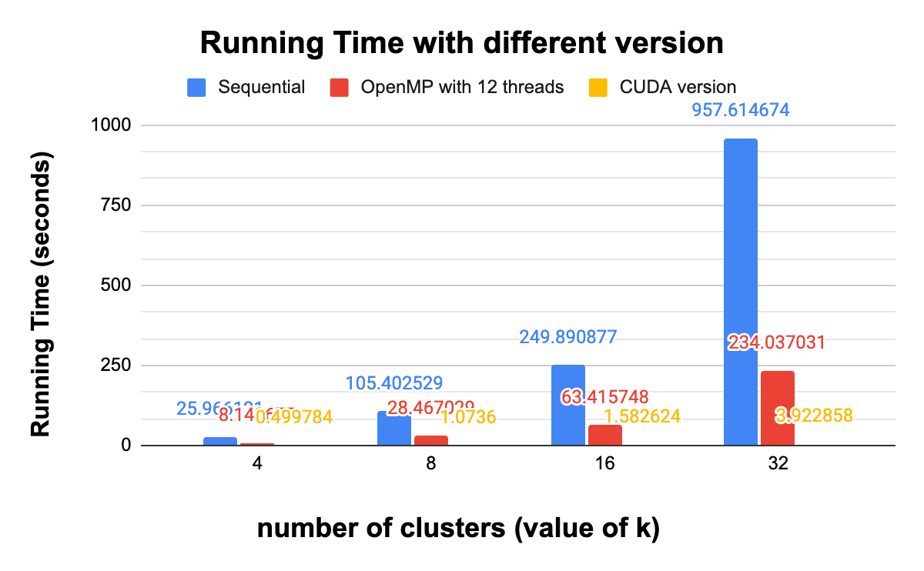
Statistical Result
Second test image (resolution = 4000x6000, size = 25.88MB)

Slide 16
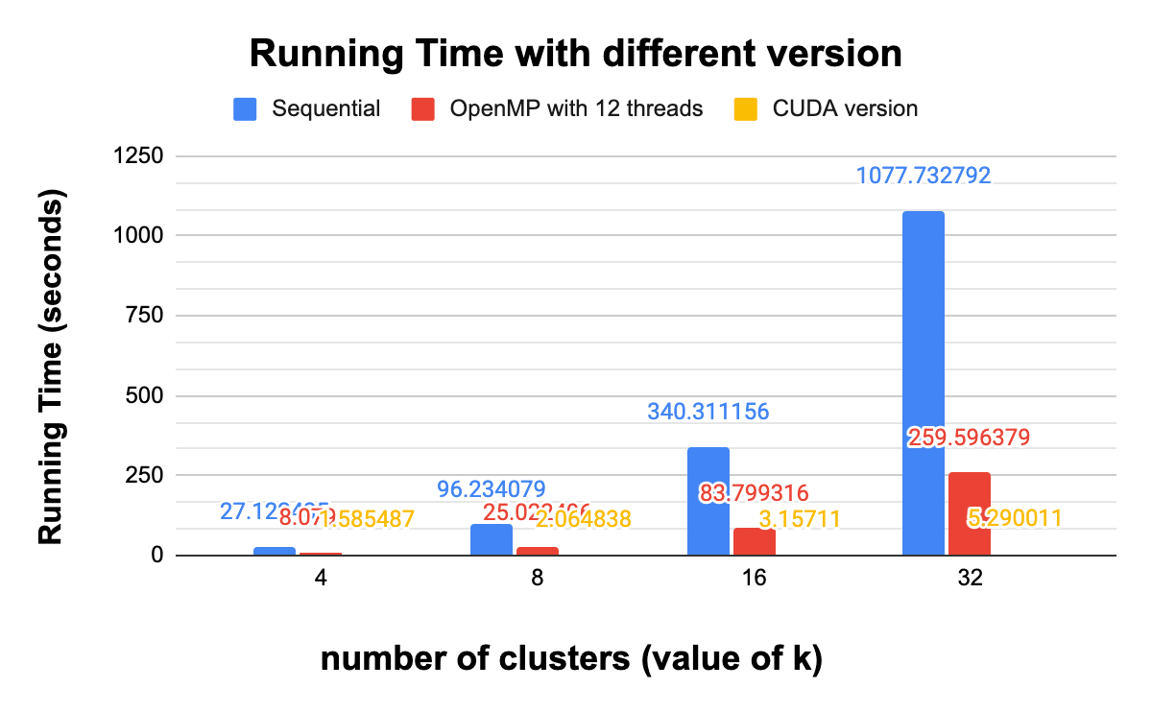
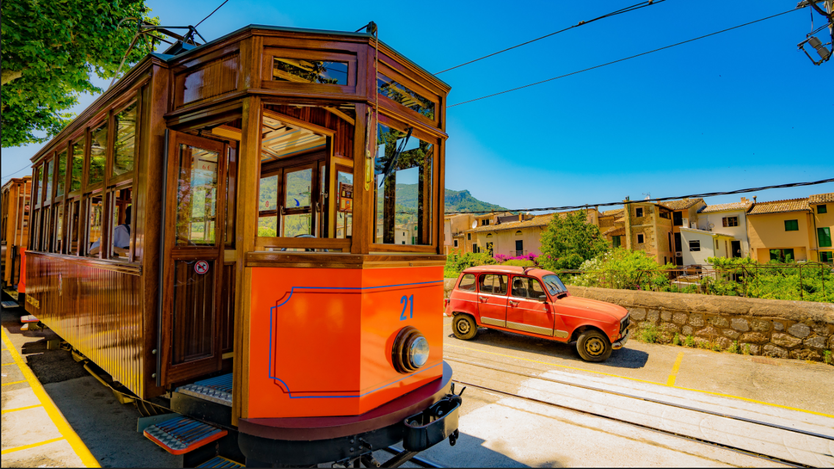
Statistical Result
Third test image (resolution = 3376x6000, size = 30.16MB)

Slide 17
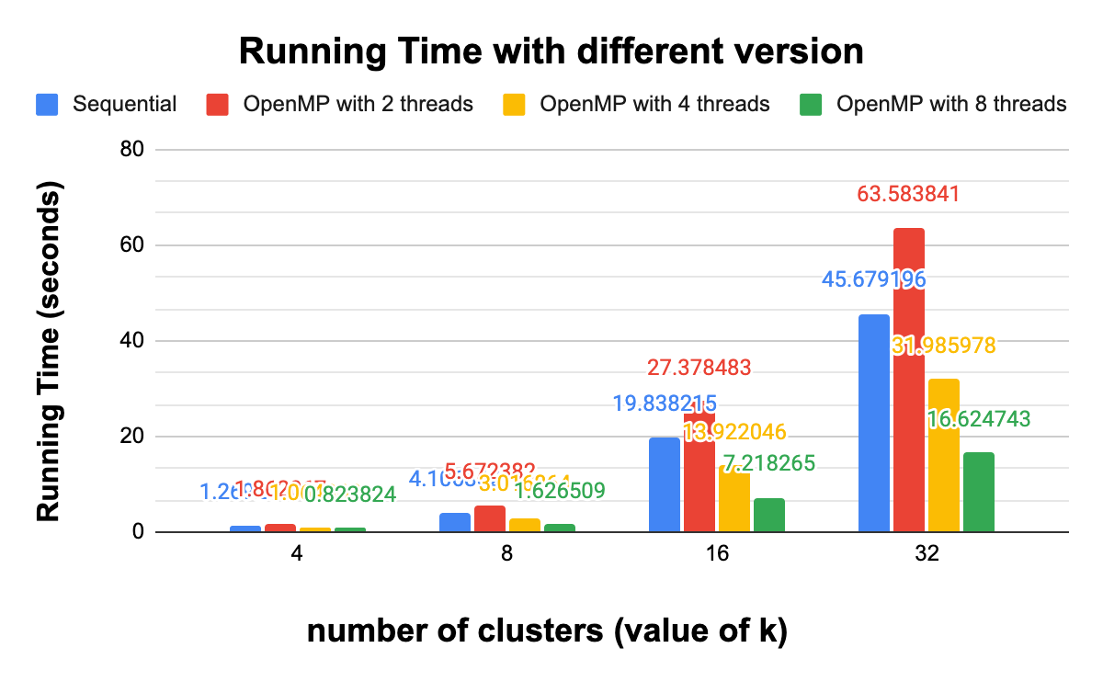
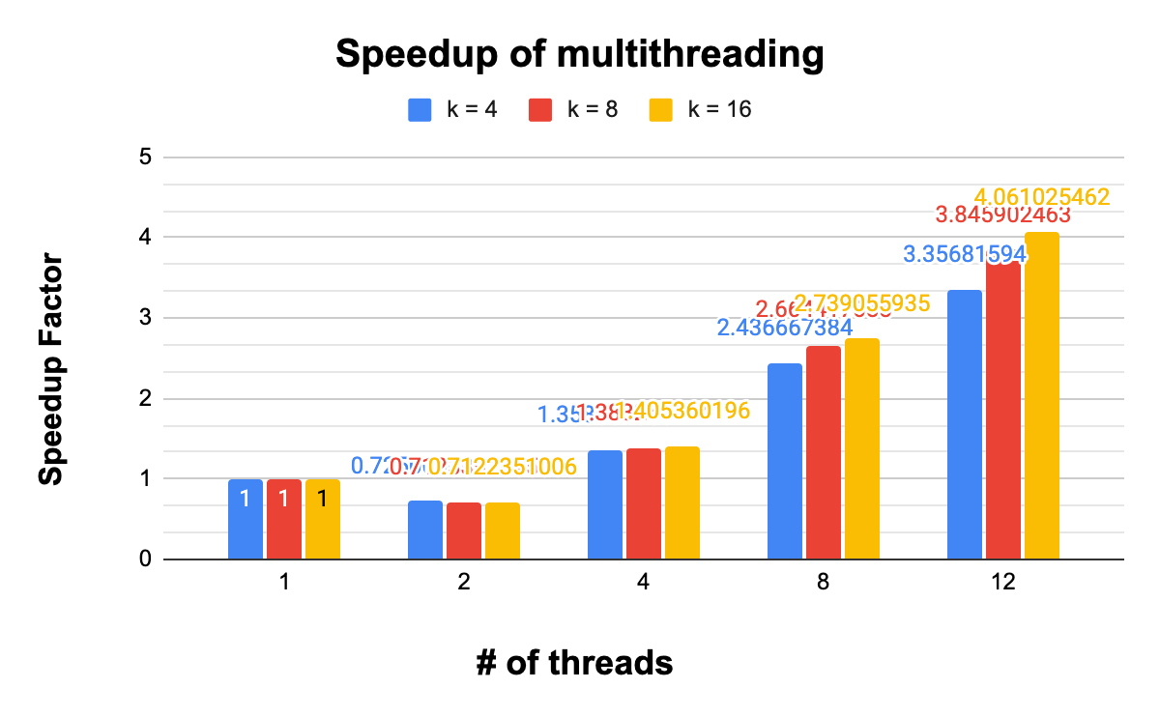
Statistical Result
Speedup of multithreading (tested on the largest test image)

Slide 18
Statistical Result
Issue of multithreading
Notes:
reduction time 與平行加速之

Slide 19
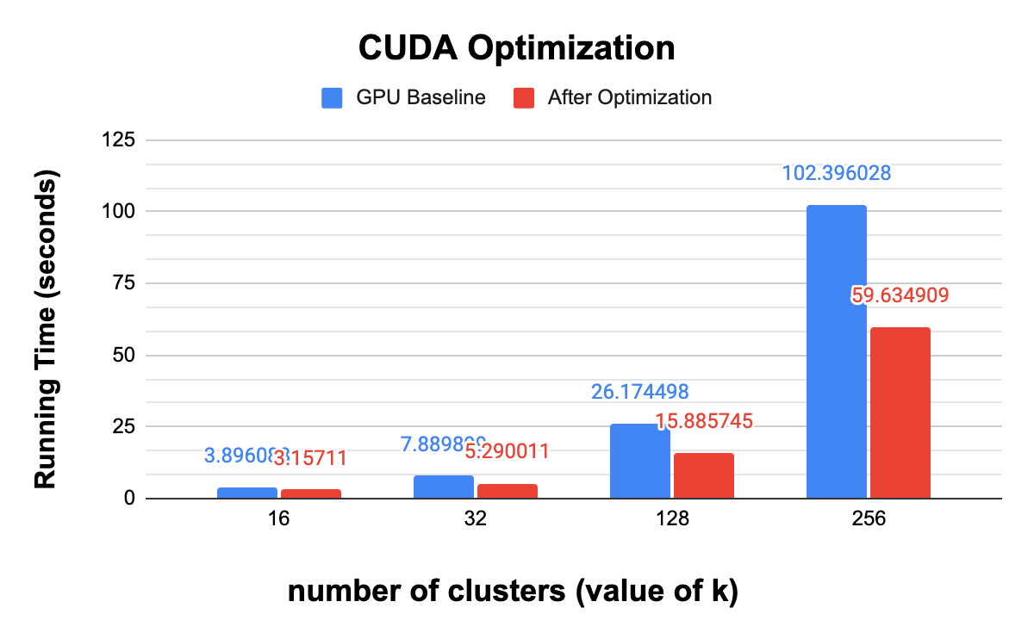
Statistical Result
CUDA Optimization (tested on the largest test image)
Add shared memory, optimize reduce function
Notes:
reduction time 與平行加速之

Slide 20
Statistical Result
Profiling Results
Achieved Occupancy: 0.876
SM Efficiency: 99.79%
Global Load Throughput: 5.6863 GB/s
Global Store Throughput: 36.251 GB/s
Integer GOPS: 30.592
Notes:
reduction time 與平行加速之

Slide 21
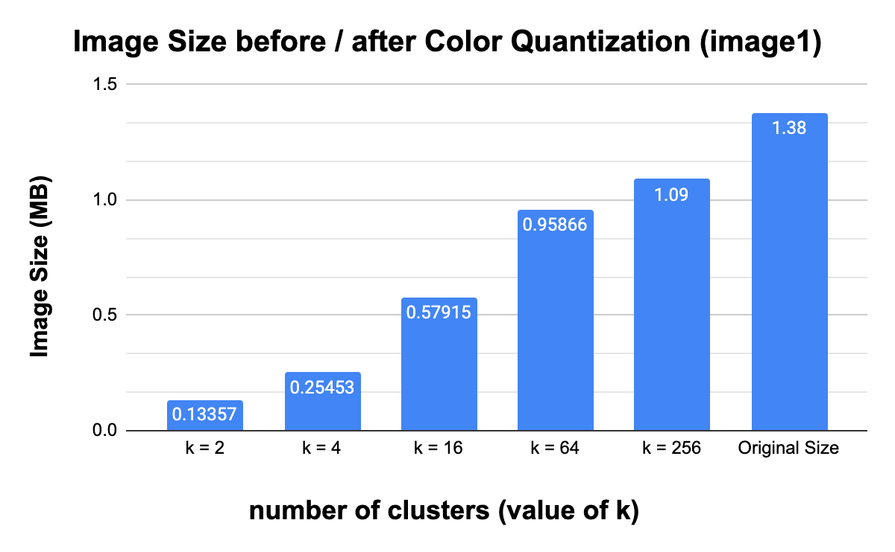
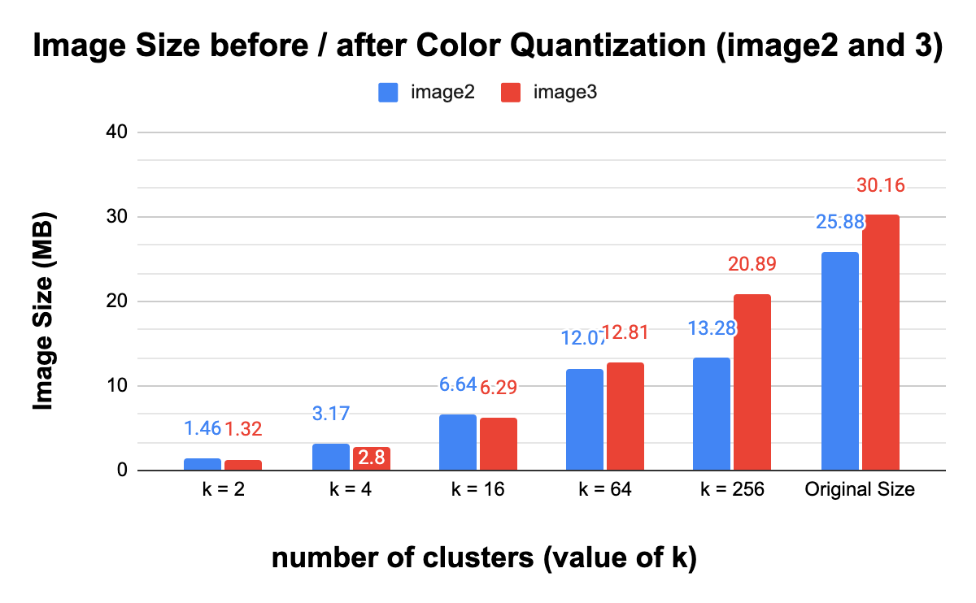
Statistical Result
Image Compression by Color Quantization
Notes:
reduction time 與平行加速之

Slide 22
Experiment Results
Statistical Results
Performance of sequential / OpenMP / CUDA
Speedup of multithreading
Issue of multithreading
CUDA Optimization
Profiling Results
Image compression of Color Quantization
Qualitative Results

Slide 23
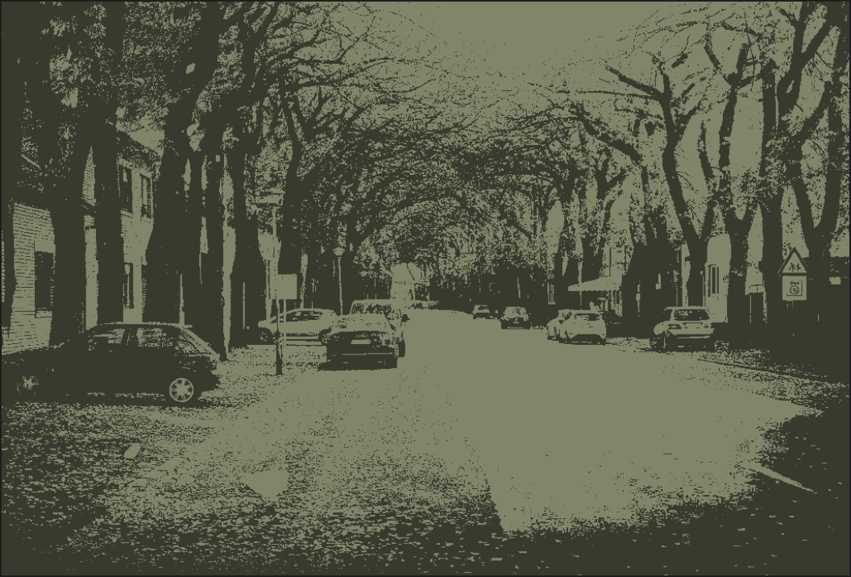
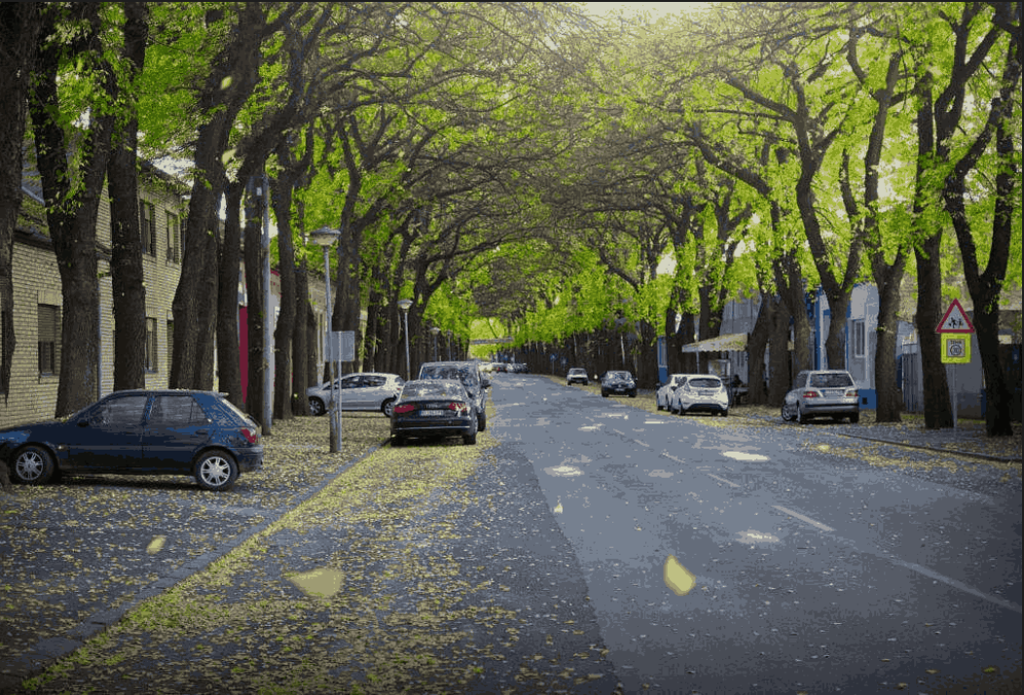

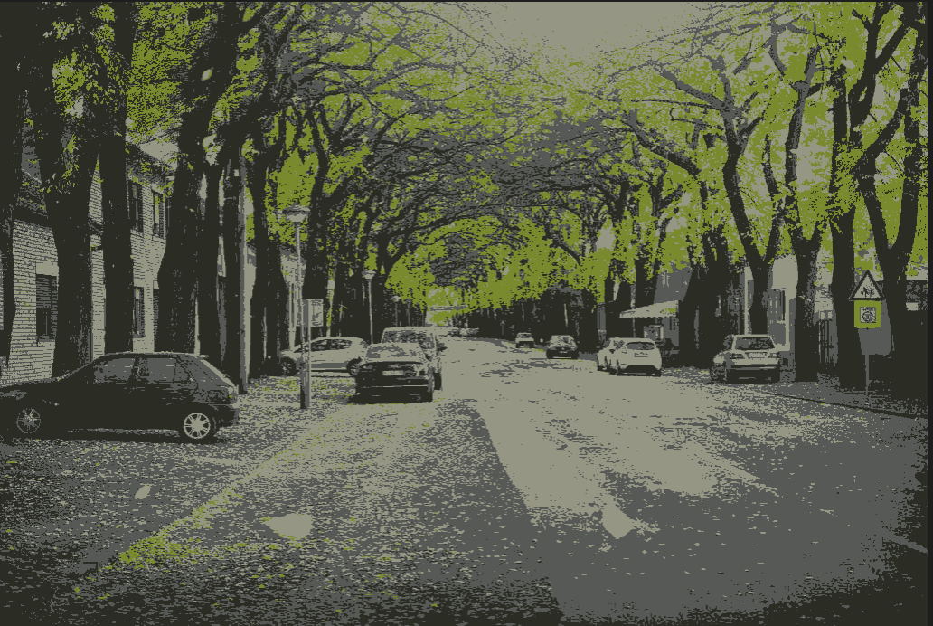
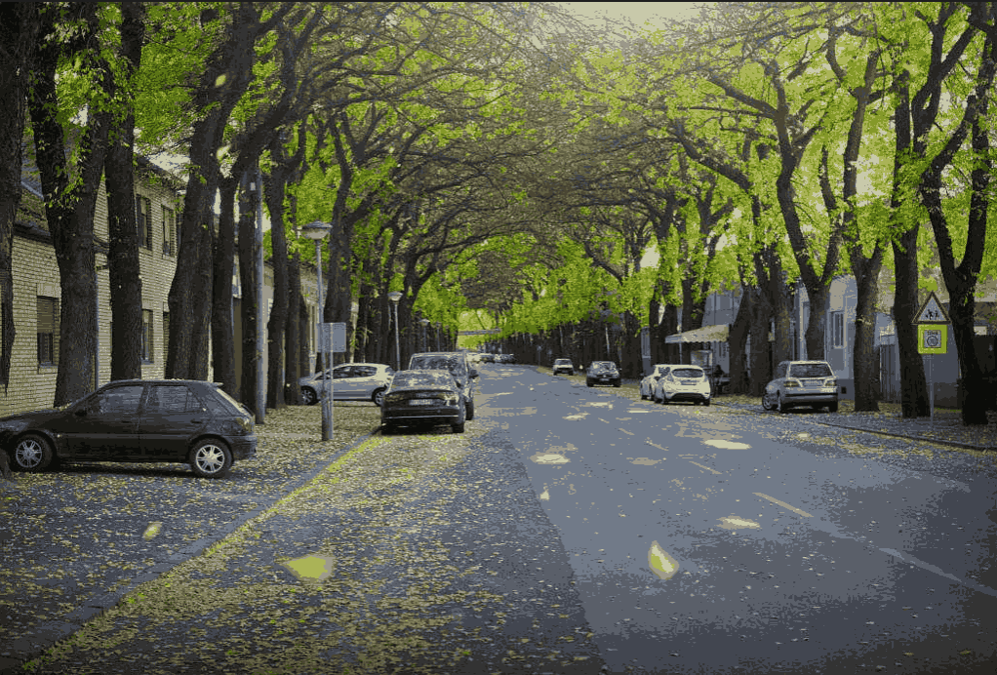
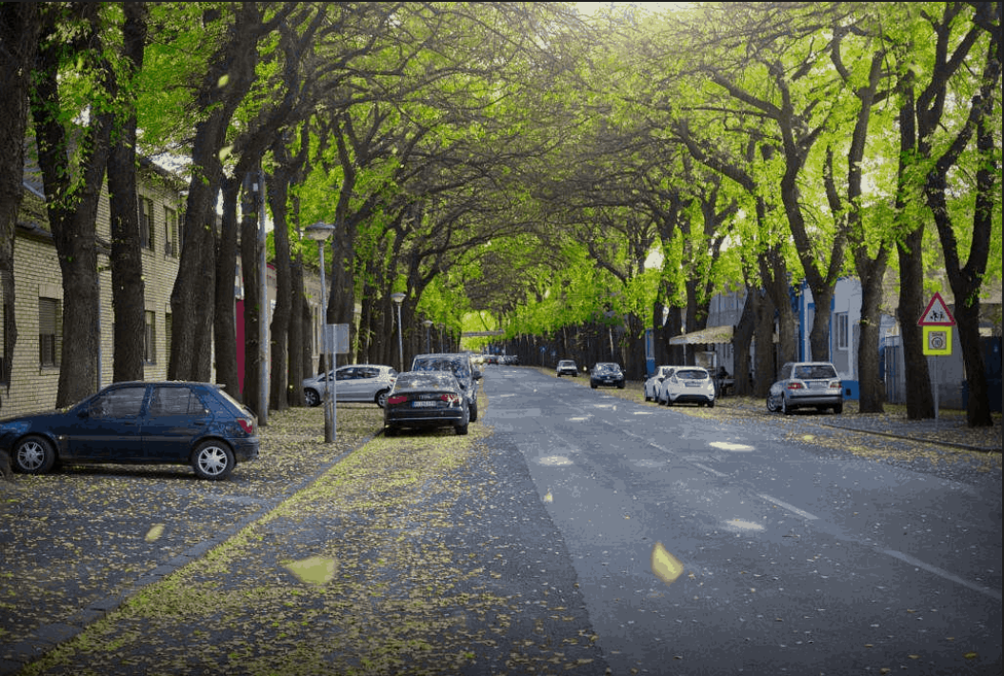
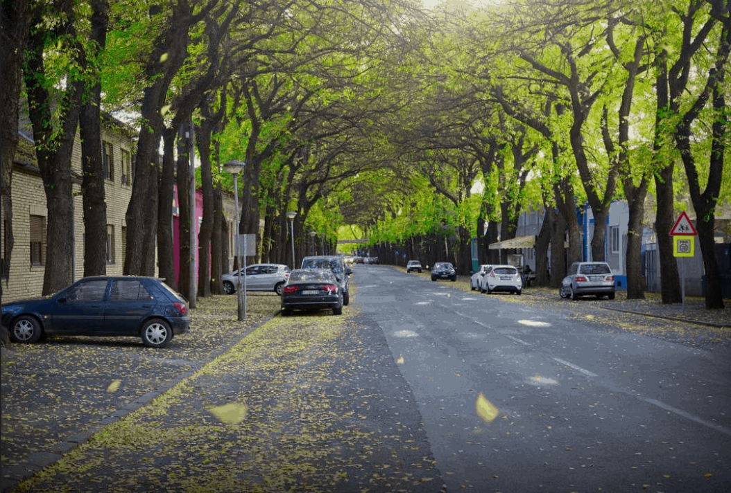
Qualitative Result
Original Image
k = 4
k = 16
k = 32
k = 64
k = 256
k = 2

Slide 24
Outline
Introduction
Problem Formulation
Experimental Results
Conclusion

Slide 25
Conclusion
Successfully implement color quantization with parallelized k-means algorithm
Implemented OpenMP / CUDA version
About 200x speedup with our largest testing data by CUDA optimization

Slide 26
Thank You !!

